Slide 1

IOT BASED AUTHORIZED DRIVING SYSTEM
ADITYA INSTITUTE OF TECHNOLOGY AND MANAGEMENT
(Approved by AICTE ,Permanently Affiliated to JNTUG V)
(AUTONOMOUS)
K.KOTT URU,TEKKALI-532201
DEPARTMENT OF INFORMATION TECHNOLOGY
Project Batch_No: 25
Presented By:
V Ramalakshmi (20A51A12C0)
V Hemanth raju (21A55A1211)
K Rahul (20A51A1294)
P Sruthi (20A51A12B0)
Supervisor
Sri.G.Jagadeeswara Rao,
Assistant Professor.

Slide 2

CONTENTS:
Abstract
Introduction
Literature survey
Objectives
Methodology
Data flow
Result Analysis
Conclusion

Slide 3

ABSTRACT:
The "Authorized Driving System" project targets the critical issue of minors and unlicensed drivers driving vehicles without permission in order to reduce possible accidents and encourage responsible ownership of vehicles. Because these drivers could not be aware of traffic laws and safe driving techniques, as well as the fact that they won't have insurance, driving without a license puts everyone's safety in danger. Our solution uses RFID technology and biometric fingerprint identification to develop a strict vehicle access control system. These technologies are integrated with an Arduino microcontroller. This system provides a safe and efficient way of vehicle access management, significantly minimizing the risk, with the main aim to permit only authorized and responsible drivers to drive the bike. This successfully stops minors from using unlawful usage of collisions caused by unlicensed and unskilled drivers.

Slide 4

INTRODUCTION:
Internet of Things(IOT):
Connecting everyday things embedded with electronics, software, and sensors to internet enabling to collect and exchange data without human interaction called as the Internet of Things (IoT).
In IOT , some popular communication protocols are used some of there are
HTTP
SPI
UART
These protocols enable devices to exchange data efficiently and securely in an IoT network.

Slide 5
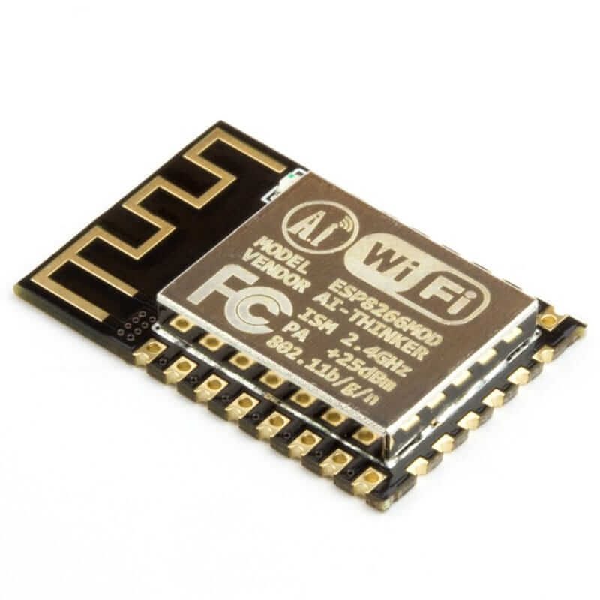
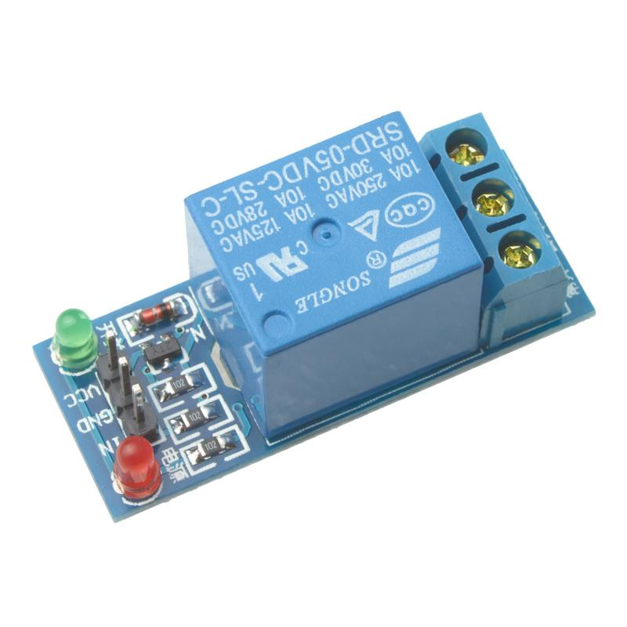

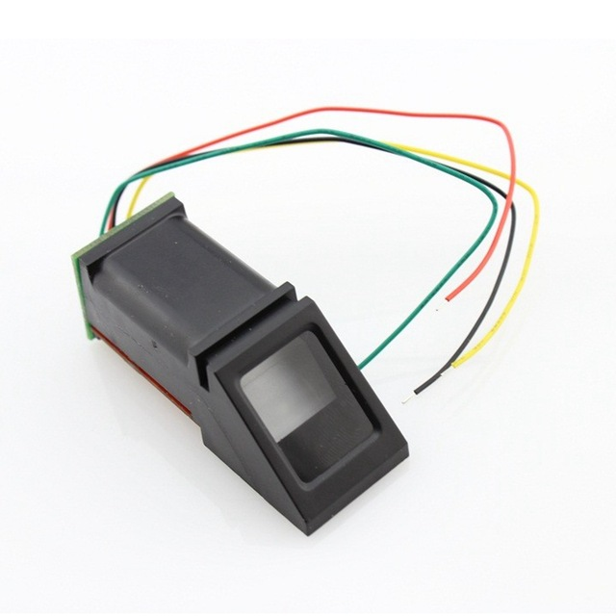
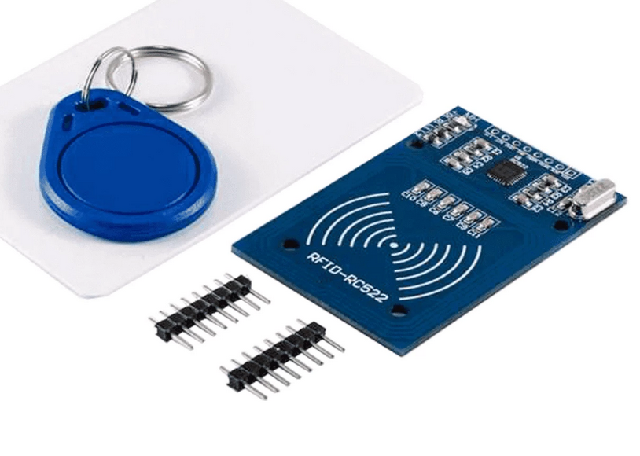
THE AUTHORIZED DRIVING LICENSE SYSTEM'S MAIN CHARACTERISTICS ARE:
Relay 5V DC
Esp8266 12f
Arduino UNO
Fingerprint (R307)
(RFIDRC522) Technology

Slide 6

Paper id/url | Author Name | Title | Publishig year | Observation
Paper [1] | N.P. Dharani Mohammed Ismail, M. Vidhya | Drunk and Drive Detection System for Safety Driving | 2022 | Car startup linked to breathalyzer; prevents drunk driving with MQ3 sensor. MEMS sensor detects accidents, sending alerts to nearby people.
Paper [2] | Ivana Maretha SiregarNancy Florida Siagian,Victor Marudut Mulia Siregar | Design of an Electric Light Control Device Using Arduino Uno Microcontroller-Based Short Message Service | 2022 | Electric Light Control Device uses SMS, Arduino Uno for remote control. C programming enhances convenience, enabling cost-efficient electricity management via cellular networks.
Paper[3] | Nipun Jain, Nikita Bhadula, Mohd Daud, Ankita Dixit | SMART-DRIVING LICENSE (An IOT-Based System for secure vehicle system) | 2021 | IoT Smart Driving License: Real-time verification, secure digital licenses for efficient authentication.
Paper [4] | I Abraham Ziegen, Joel Manova M and Dr. A Akilandeswari | License Verification System With Face Recognition Using IOT | 2021 | Integrating facial recognition with IoT devices for license verification enhances security, prevents identity theft, and automates processes for efficient operations.

Slide 7
Paper id/url | Author Name | Title | Publishig year | Observation
paper [5] | Mr. Prahith N, Ms. Pubali , Mr. Koushik Shridhar ,Ms. Aishwarya S V ,Prof. Sridhar C S | IoT based Automatic Driving License Test | 2020 | Driving test system: Arduino monitors candidates, wirelessly notifies results via IoT and GSM modules. Enhances road safety, improves license standards
paper[6] | Arwa M. Ali,Dr. Heisum M. Awad brahim K. Abdalgader | A fingerprint Based Ignition System in vehicles | 2020 | Create and put up a biometric access control system that verifies users through fingerprint scanning and recognition. The scanner for fingerprints makes use of serial transmission. The user will be able to safely view all driving-related documents upon successful login.
paper [7] | Dr. Fathima Jabeen, Sudhir Rao Rupanagudi, Varsha G Bhat | IoT based Smart Vehicle Ignition and Monitoring System | 2019 | Vehicle scans driver's face, matches it; checks alcohol level. If sober, ignition starts; otherwise, ignition won't turn on for safety.
paper[8] | Ortiz, K. J. P., Calicdan, M. N. T., Ona, R. P., & Torres, R. F. H. | GSM-Based Automobile Ignition Stopping and GPS Tracking with Thief Image Capturing | 2019 | Three microcontrollers activate when car idle. PIR detects thief, hall sensor monitors speed. GPS/GSM alert owner, fingerprint alerts user, triggers off-state for security.

Slide 8
OBSERVATION
According to the literature study above, the majority of research has been done on face recognition for security purposes and observed accuracy problems, particularly when different lighting conditions or facial traits are used.
Benefits of the Suggested System include:
Therefore, by using mfrc522 (RFID) for license ID scanning and r307 for fingerprint authentication, this solution offers increased security.
Increased security via biometric identification.
Instant license validity verification.

Slide 9
PROPOSED SYSTEM:
"IOT Based Authorized Driving System" verifies users with license and fingerprints.
Components: RFID reader (mfrc522), fingerprint sensor (r307), microcontroller, Wi-Fi module (esp82266),relay module(5v).
System scans RFID tag on license, verifies license number in database.
Fetches associated fingerprint template for user verification.
If matched, triggers relay for ignition system to the on state.
Comprehensive approach for secure and authorized vehicle access.

Slide 10
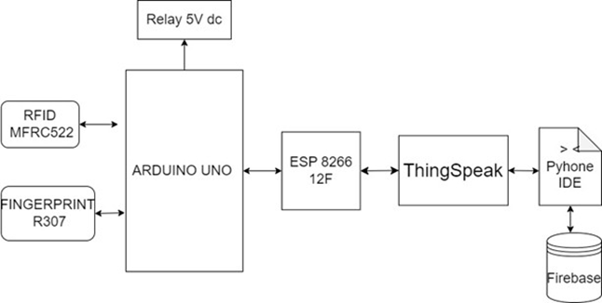
SYSTEM ARCHITECTURE

Slide 11
Check for a match between RFID data and fingerprint ID.
Print validation status.
Repeat the loop for continuous RFID and fingerprint interaction.
Handle authentication, data reading, and verification functions as needed.
Analyze data to trigger relay5vdc for valid authorization, redirect otherwise.
Connect ESP8266 to Thing Speak, validate, and ensure data integrity.
Fetch stored data files from Firebase for fingerprint matching using Python.
Use the SIFT algorithm for fingerprint matching and verify authentication accuracy.
Send matching accuracy data to Thing Speak for validation.

Slide 12







OBJECTIVES: THE OBJECTIVES OF THE "AUTHORIZED DRIVING SYSTEM" PRIMARILY REVOLVE AROUND CREATING A SECURE AND RESPONSIBLE VEHICLE ACCESS CONTROL SYSTEM.
Preventing Unauthorized Vehicle Usage
RFID-Based Identification
Biometric Authentication
Enhancing Safety and Responsibility
Integration of IoT for Seamless Operations
Real-time Authentication and Decision Making
Ensuring Data Integrity and Validation

Slide 13
METHODOLOGY
Hardware Components:
Arduino Uno
RFID Card Reader (MFRC522 Library)
Fingerprint Sensor (Adafruit_Fingerprint Library)
ESP8266 12F for Communication with ThingSpeak
Relay 5v
communication protocols:
SPI (Serial Peripheral Interface)
Software Components:
Arduino IDE ad required libraries
ThingSpeak and Firebase APIs
Python IDE and required libraries

Slide 14
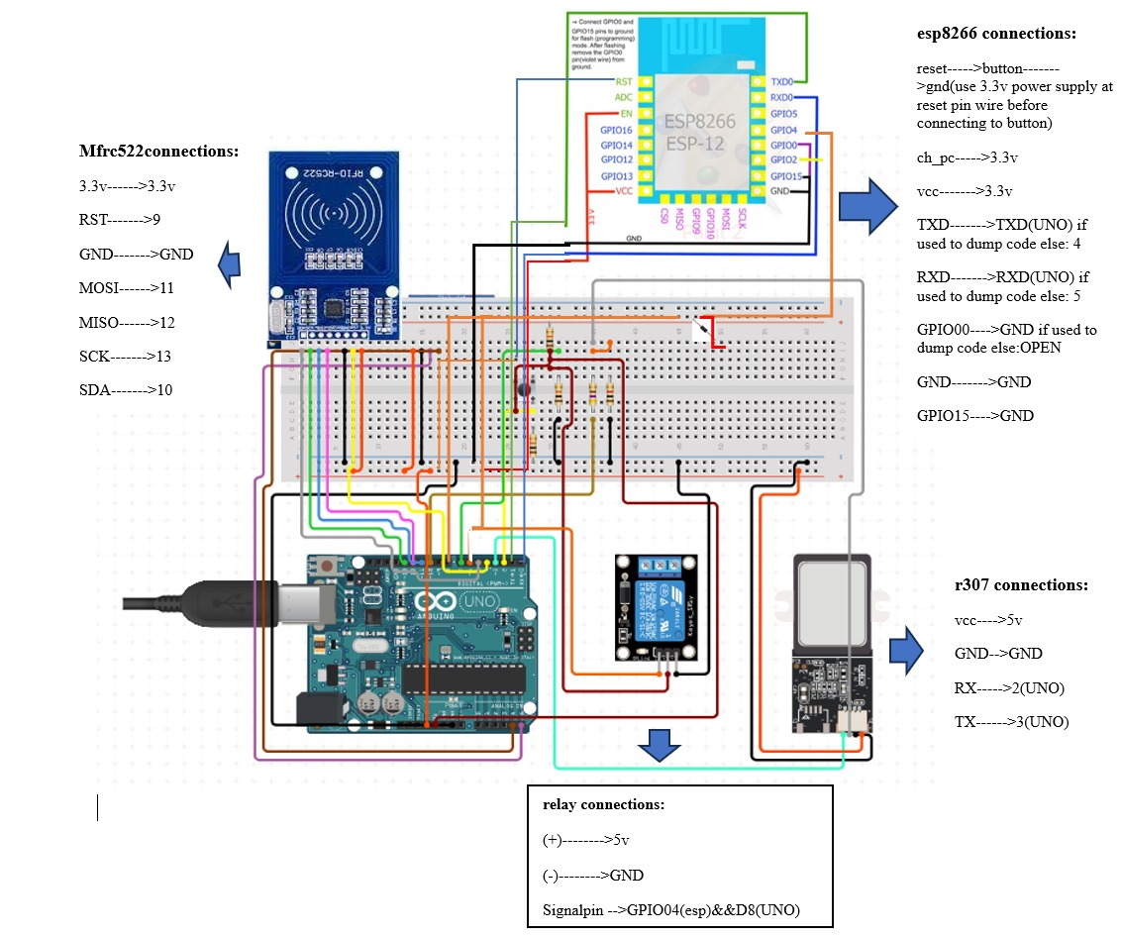
SCHEMATIC DESIGN

Slide 15
RFID AND FINGERPRINT AUTHENTICATION PROCESS
System initialization :Initialize Serial,SPI, MFRC522, and Adafruit_Fingerprint.
Define RFID and fingerprint data variables.
Authenticate fingerprint sensor and RFID card.
Enter loop to detect RFID card and perform fingerprint verification.
1
2
3
Read specified RFID blocks and concatenate data.
Check for a match between RFID data and fingerprint ID.
Print validation status.
6
7

Slide 16
INTEGRATED SECURITY SYSTEM: AUTHORIZATION, THINGSPEAK CONNECTIVITY, DATA VALIDATION, FINGERPRINT MATCHING, AND COMMUNICATION PROTOCOL
Analyze data to trigger relay (5VDC) for valid authorization; redirect otherwise.
Connect ESP8266 to ThingSpeak for data transmission.
Validate and ensure data integrity during transmission to ThingSpeak.
Fetch stored data files from Firebase for fingerprint matching using Python.
Other wise
Utilize the SIFT algorithm for fingerprint matching to verify authentication accuracy.
Send matching accuracy data to ThingSpeak for validation.
Communicate validation information back to Arduino Uno through ESP8266.

Slide 17
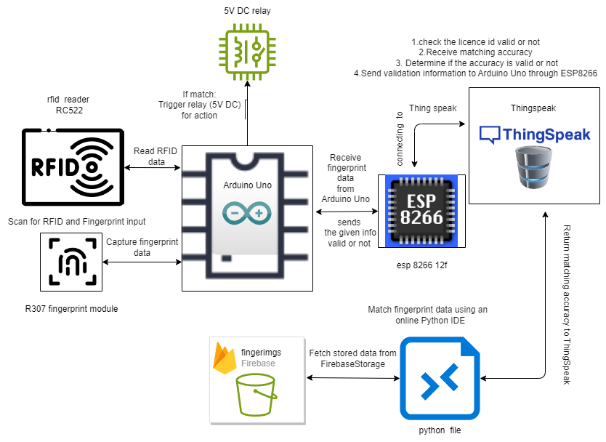
DATA FLOW

Slide 18
RFID and Fingerprint Integration:
Establish two-way communication with Arduino Uno, RFID RC522, and fingerprint R307 for data gathering and analysis.
Trigger relay5vdc for valid authorization; redirect unauthorized data flow to ESP8266 for further processing.
Thingspeak and ESP8266 Connection Verification:
Transmit Arduino Uno's data flow to ESP8266 for ThingSpeak connectivity.
Utilize ThingSpeak to validate data integrity and ensure authentication verification.

Slide 19



Firebase Data Retrieval and Fingerprint Matching:
ThingSpeak and Arduino Uno Feedback:
System Safety and Authentication:
Fetch data files from Firebase Storage for fingerprint matching via Python IDE.
Implement a matching algorithm to determine accuracy.
Send matching accuracy data to ThingSpeak for validation.
Communicate validation information to Arduino Uno through ESP8266.
Allow relay5vdc activation for authorized individuals.
Validate sensor data to prevent unauthorized bike access.

Slide 20
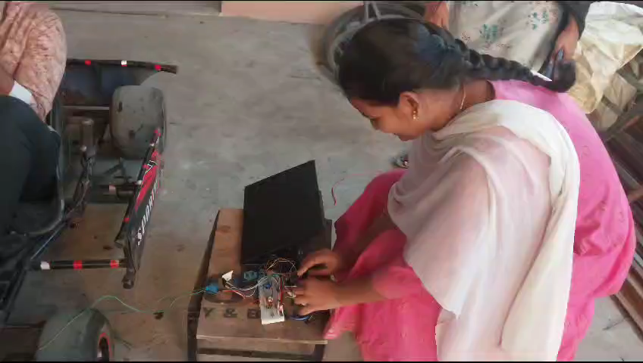
RESULT ANALYSIS
VALID AUTHENTICATION

Slide 21
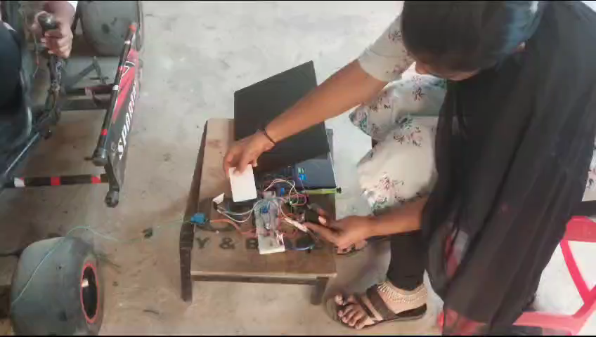
INVALID AUTHENTICATION

Slide 22
CONCLUSION
Minors and unlicensed drivers operating vehicles pose a safety risk.
RFID and biometric fingerprint identification implemented for robust vehicle access control.
Efficient and reliable integration with Arduino or Raspberry Pi microcontrollers.
Strict control to reduce risks associated with unlicensed and inexperienced drivers.
Successful prevention of unauthorized vehicle usage for enhanced road safety.
Minimizes potential accidents caused by unqualified drivers.
Aligns with promoting responsible ownership and safer driving practices in the community.

Slide 23

THANK YOU

